Slide 1
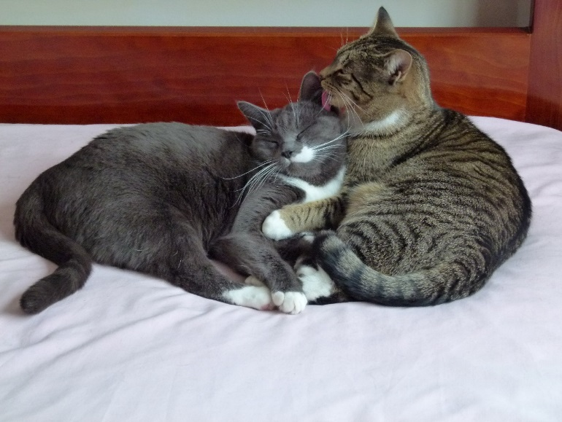
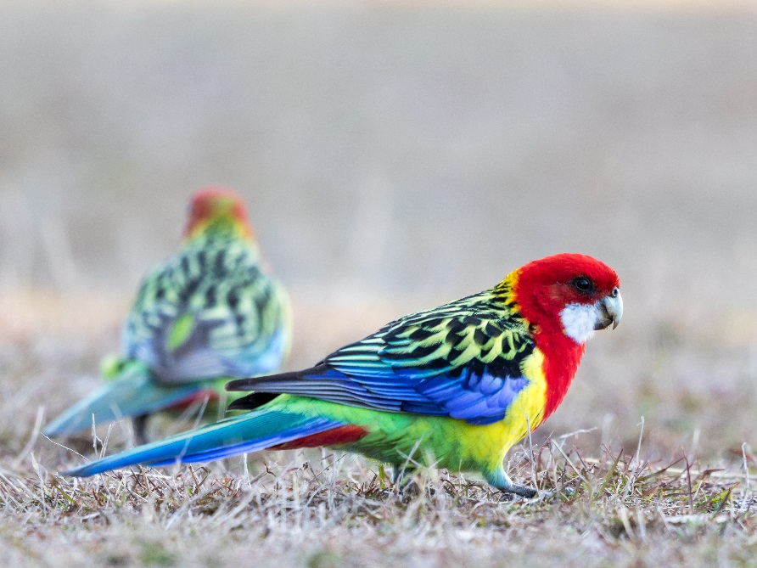
Improving Cat Management in the ACT
SAFE CAT
SAFE WILDLIFE

Slide 2
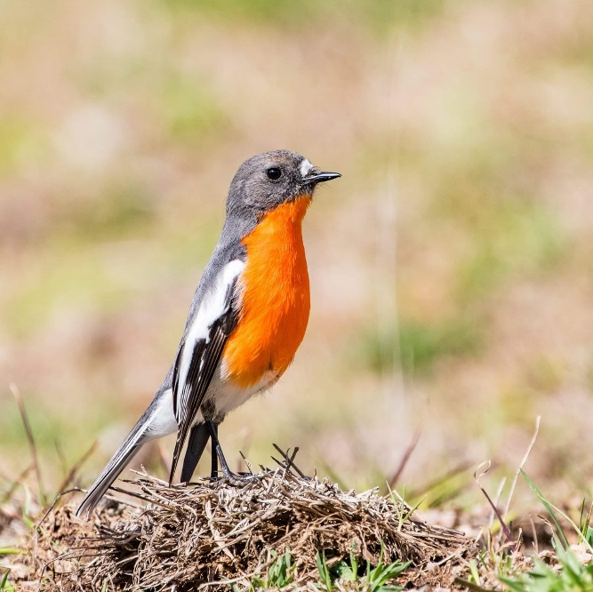
Why manage cats
Improve animal welfare
Reduce impact on the environment
Reduce nuisance
Reduce risk to human health
Improve services
Provide certainty for cat owners

Slide 3
Policy Context
2000 - Domestic Animals Act - declare cat curfew , compulsory desexing
2005 – DA Act - Cat Containment Amendment Bill - compulsory micro-chipping, 24 hr containment
2017 – Animal Welfare and Management Strategy

Slide 4
Cat Containment
Confine cat to premise in cat declared areas.
Since 2011 new suburbs declared.
In 2018, 15 suburbs ~ 12% of ACT suburbs

Slide 5
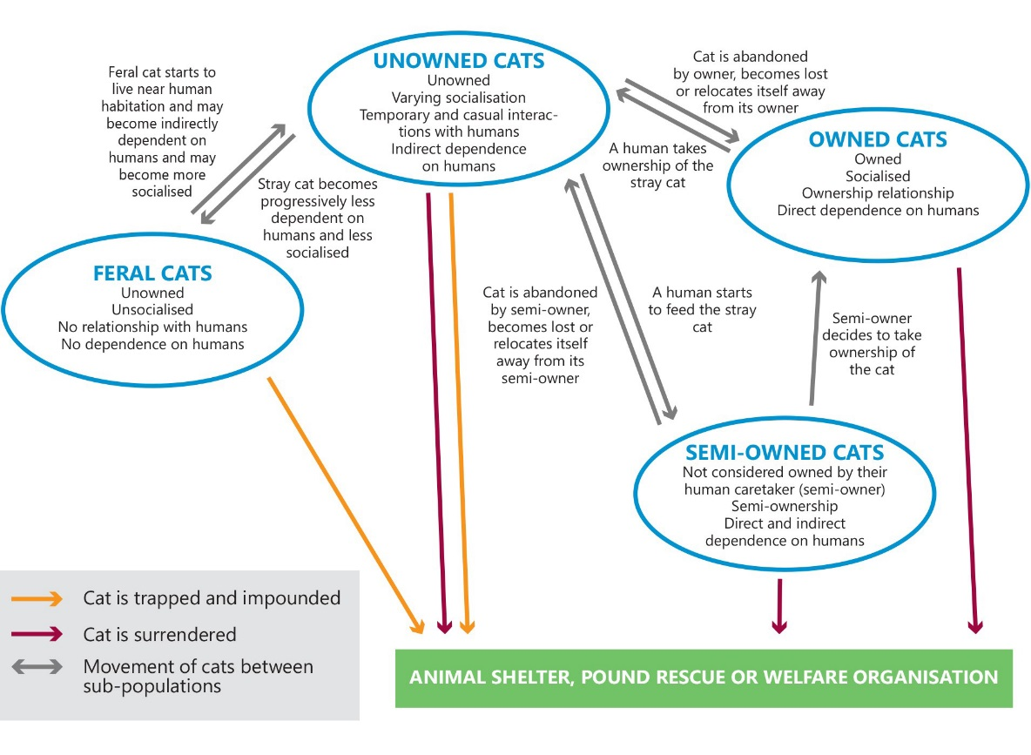
Comprehensive cat management
All cats
Domestic – Owned, semi-owned, unowned
Feral
All areas
Urban, Nature reserves, rural
All issues
Human health

Slide 6
Focus - safe cat, safe wildlife
Responsible pet ownership
Contain pet cats
Manage cats that are not owned

Slide 7
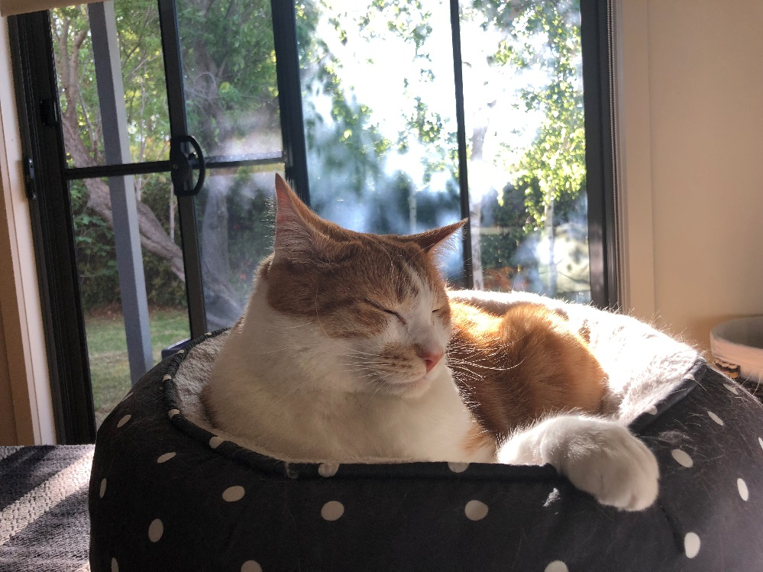
1. How to promote responsible pet ownership
Key issues
Micro-chip
De-sex
Containment
Awareness raising
Understanding barriers

Slide 8
2. How to expand cat containment
Key issues
Different areas (new and old suburbs, rural areas)
Timeframes for existing cat owners

Slide 9
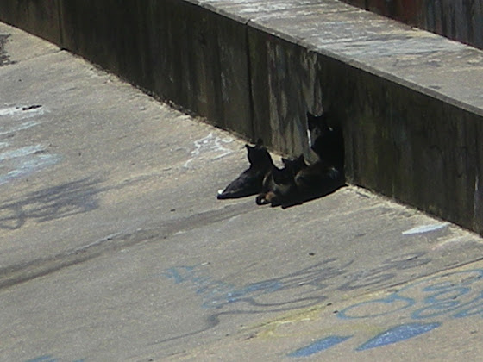
3. How to manage cats not owned
Key issues
Semi-owned
Unowned
Feral

Slide 10
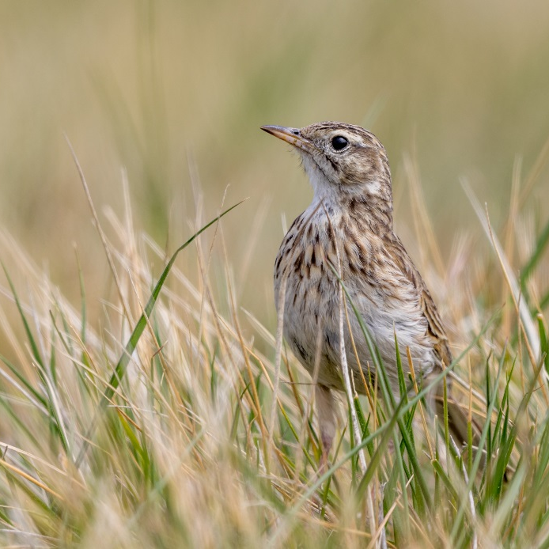
Next steps

