Slide 1
South Coast Forests What can we do to help?
Joslyn van der Moolen, Canberra Forest Alliance and Coastwatchers Yuin Country Harriet Swift, South East Region Conservation Alliance 28 April 2021
Notes:
Intros: Harriet Swift South East Region Conservation Alliance Maddie ACT Conservation Council Chat manager Qns
Joslynvdm Coastwatchers Welcome Attendees I’d like to acknowledge that I am on Yuin Country. Please introduce yourselves in the chat.
(Pdf will be sent to participants. Info & links on a website soon)

Slide 2
Tonights info sharing
I am a south coast based member of Canberra Forest Alliance. I will advise a range of activities Canberra people can get involved in - some local, some on the south coast.
Links to all events and activities covered will be sent to participants
Canberra Forest Alliance will answer all queries about any of these and forward to the relevant group.
Canberra Forest Alliance forestnwk@gmail.com is on Facebook
Joslyn van der Moolen Secretary Coastwatchers Association Inc - South Coast NSW

Slide 3
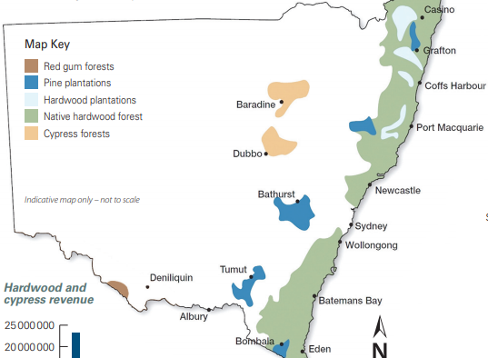
Forestry Corporation of NSW (forestry) logs 1 million hectares of native state forest (green)
FIRES 13 million hectares burnt (4 billion fauna lost) in the summer fires.
In the Eden Region 79% was burnt
In the Southern Region 81% was burnt
LOGGING IN NSW

Slide 4
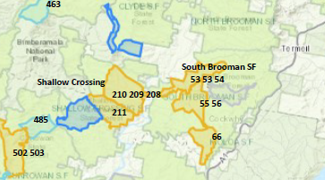
Logging in your local holiday area on the NSW Forestry Portal
Eg between Batemans Bay and Ulladulla
At https://planportal.fcnsw.net
The colour coded areas indicate the status of planned and active logging throughout NSW.
Yellow (planned)
18 compartments due to be logged in next 12 months
WHERE AND WHEN?

Slide 5
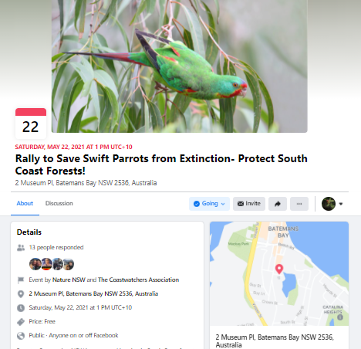
Immediate Actions Upcoming Rallies
Forestry Corporation NSW has resumed logging in South Coast forests devastated by bushfires. These forests need far more time for recovery- logging now will further worsen this ecological disaster.
One of the species most at threat is the critically individuals left in the wild, they are on the brink of extinction. Swift Parrots will shortly be migrating from Tasmania back to the forests of South-East Australia, including along the South Coast. This year, they will be returning to forests which are planned to be logged.
Join us on a short march and rally at Forestry Corp's South Coast offices to tell the government enough is enough- the community will not allow anymore destruction of the region's beautiful forests for woodchips! Bring banners, placards and anything Swift Parrot themed.
PS- If you are unable to join for the march, you can join the rally at 1:15pm at 2 Crown Street, Batemans Bay.

Slide 6
Immediate Actions and Ways to Help - Rallies
Paint Banners with Artivists for upcoming rallies
Mondays 10.30-12.30 at ACT Conservation Council
ECO-TOURISM NOT LOGGING TOO PRECIOUS TO LOG END NATIVE FOREST LOGGING
Help organise next rally at
Barilaro’s office in Queanbeyan
Shelley Hancock’s office in Nowra

Slide 7
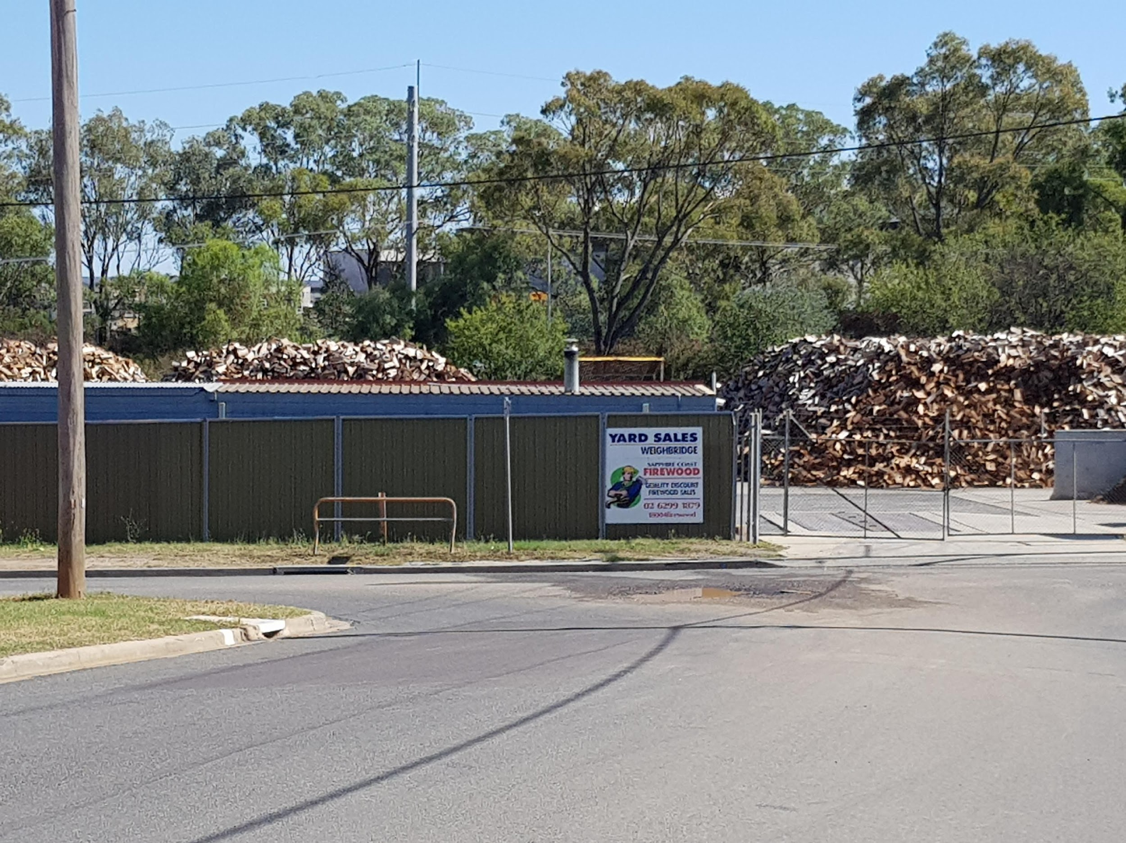
Sustainable Firewood Campaign
Work with Canberra Forest Alliance on getting sustainable firewood code for SE region rnment (not from native forests)
Lobbying ACT MLAs
Alternatives:
sourcing from logging waste
community firewood lots/plantations
Work with MTB Club on tracks being logged on south coast
Notes:
Refs:
Bushfire Affected Operations Site Specific Conditions
See EPA September update letter to FCNSW.

Slide 8
Work on ACT Gang Gang Cockatoo Project
Following the bushfires, the federal Environment Department drew up a list of species requiring priority "management intervention." The Gang gang was one of these.
On Sunday the federal Minister Sussan Ley announced plans to have several States and organisations to lead long term recovery actions.
The ACT Government has been given responsibility by Minister Ley to “lead on-ground action like habitat protection, pest animal control, monitoring and research to assist their species” over next 15 months.
The scope of the project extends beyond the ACT to any relevant areas important to the recovery of the species. This should include south coast forests and ACT residents could have an important role in ensuring that it does. Gang gangs need tree hollows for breeding and will suffer if habitat forests with current or future hollows are logged. If hollows are saved, many other species will also benefit.
There's an article about it here:

Slide 9
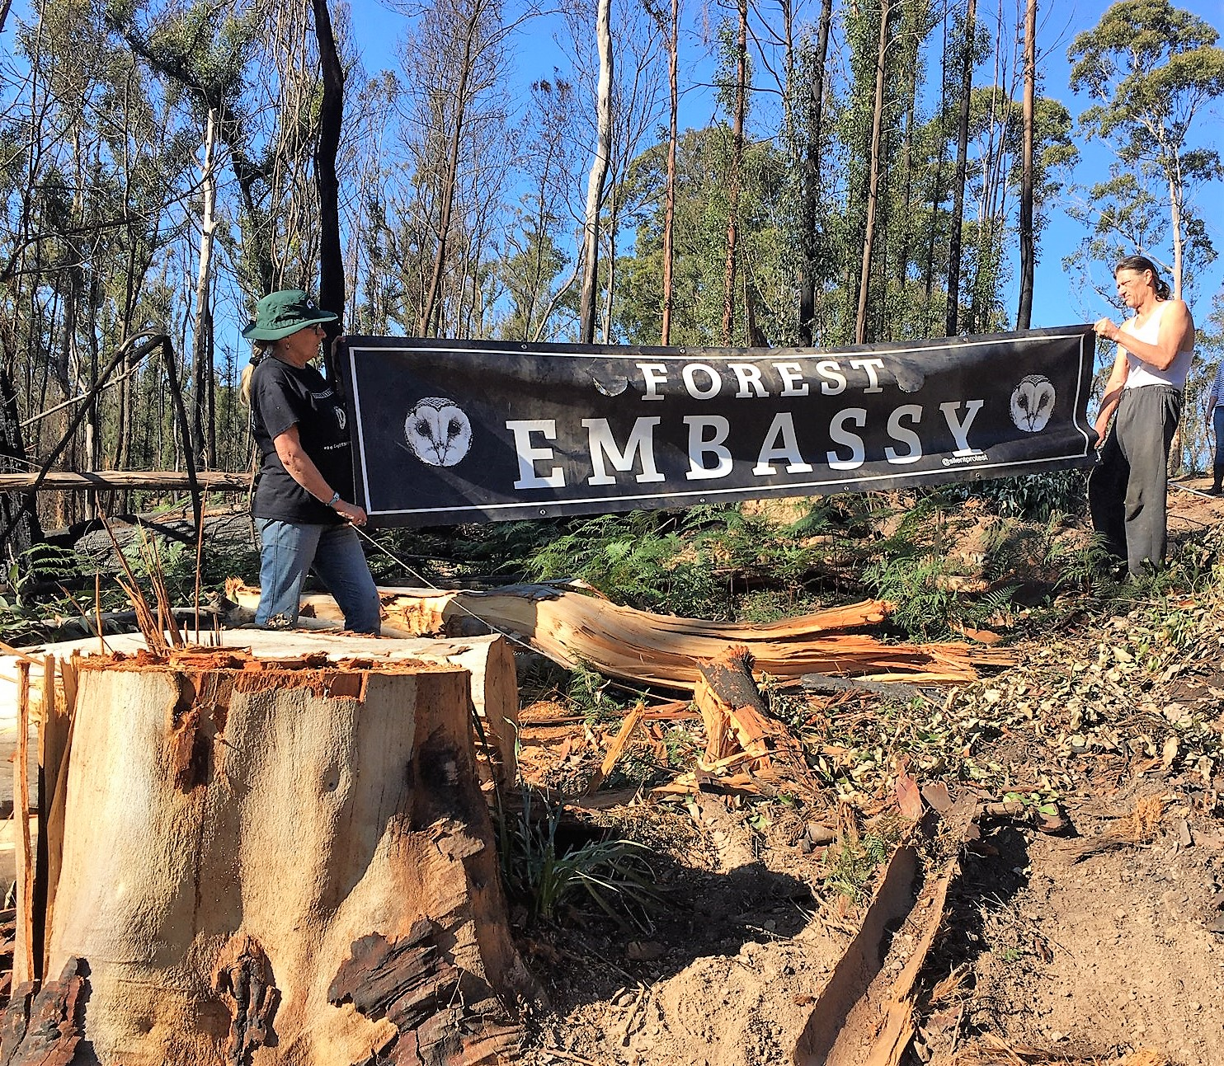
Forest Tours to see logging
Sunday 9 May 9.30 -12.30 Mogo State Forest
Sunday 16 May 8.30 - 12.30 Shallow Crossing State Forest (Forest Survey)
Sunday 23 May 9.30 -12.30 Mogo State Forest
(or sign up for next one)

Slide 10
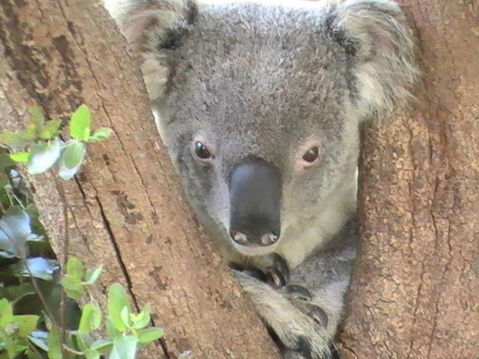
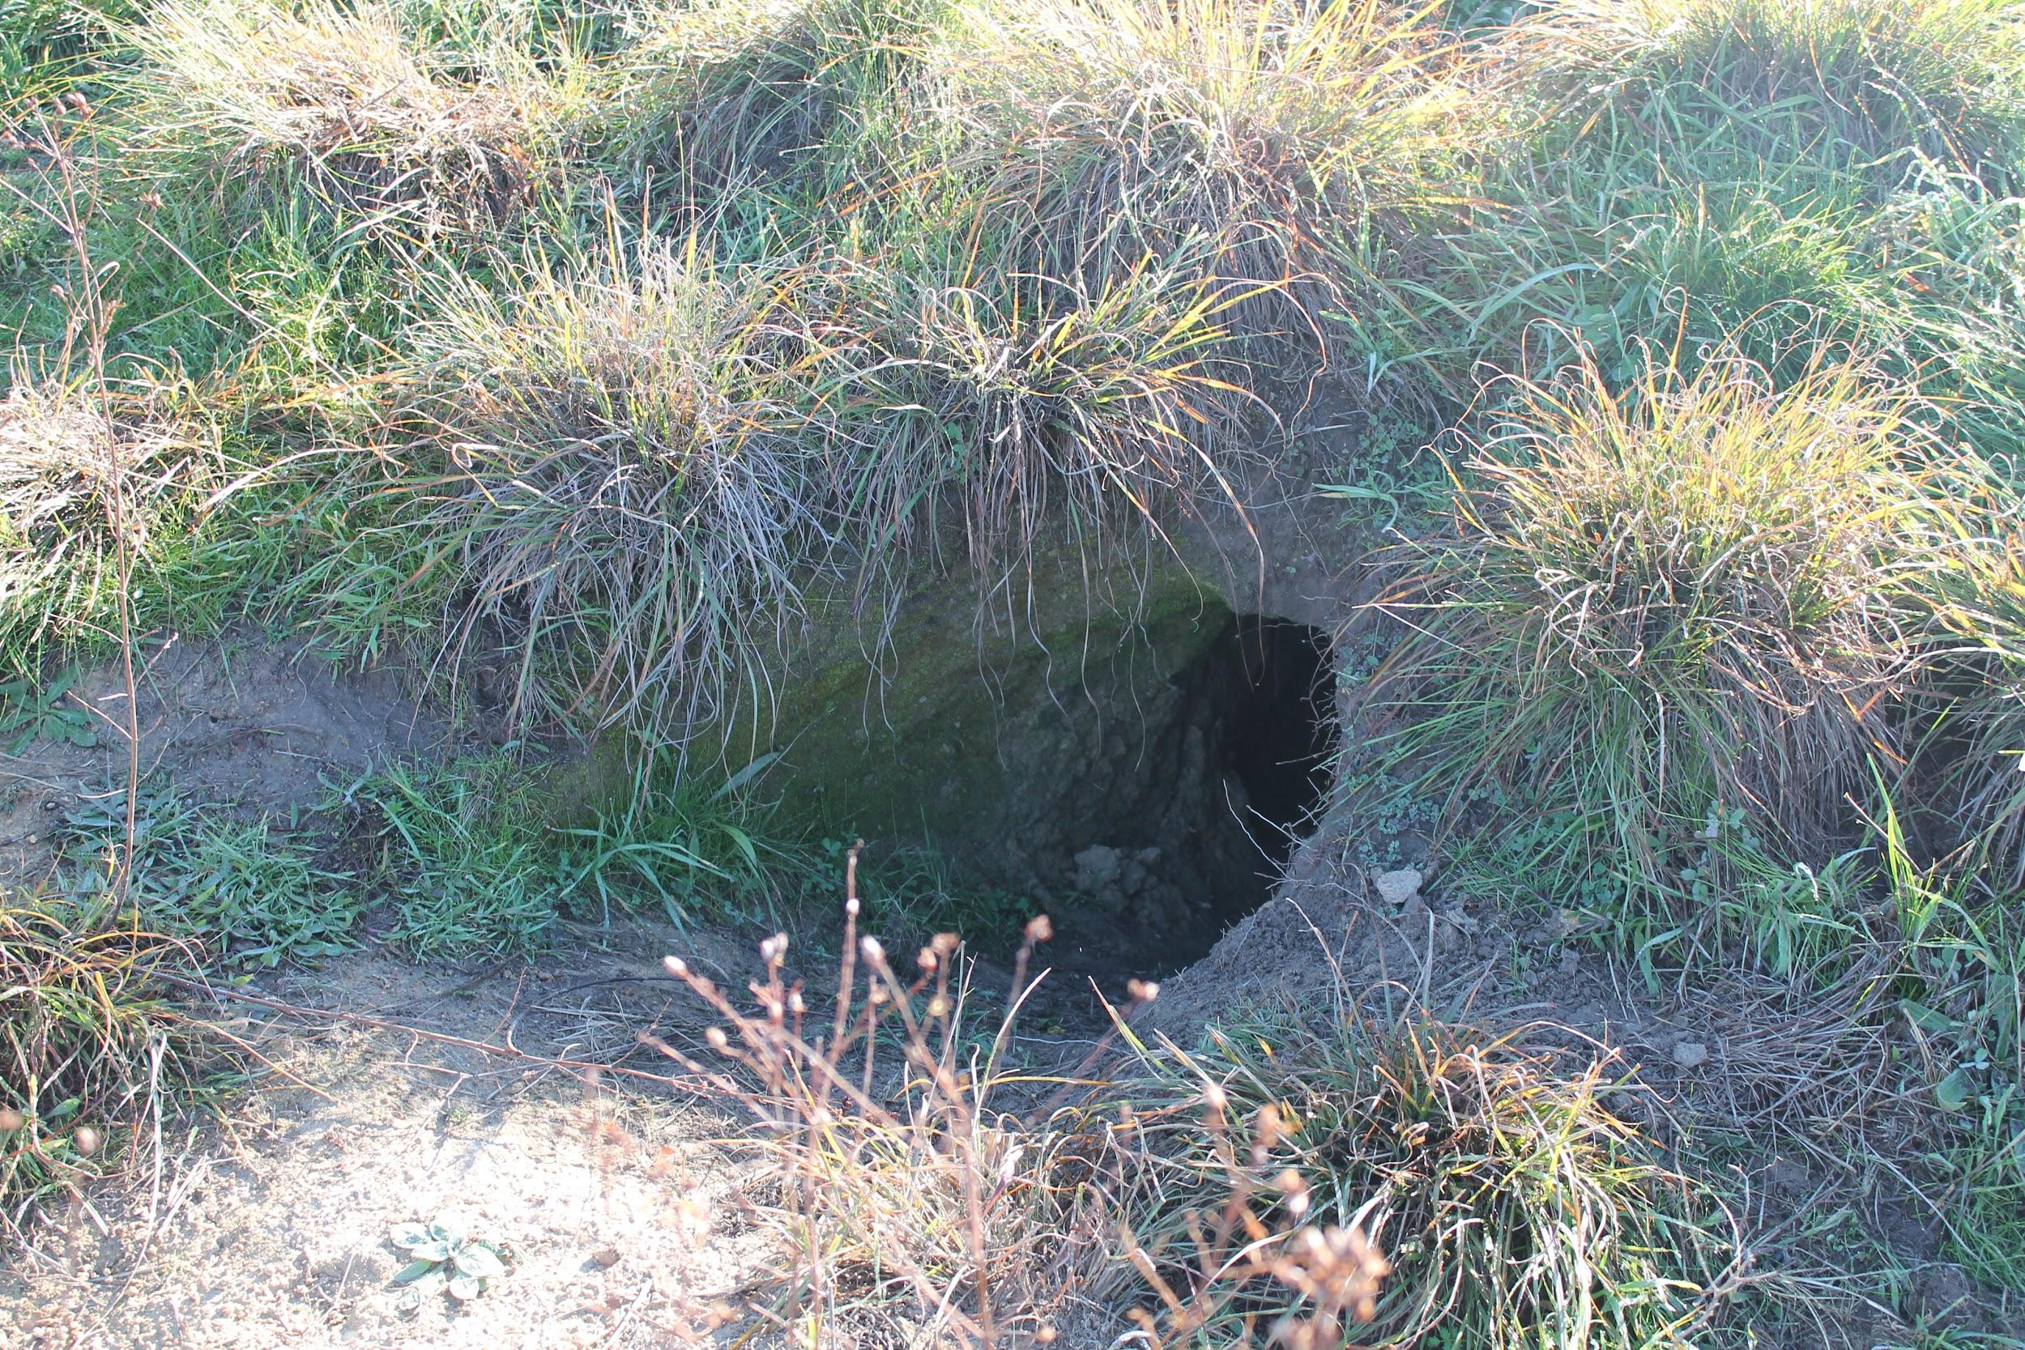
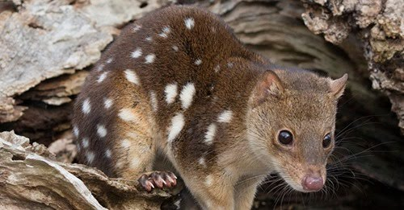
Mammal Surveys contact@coastwatchers.org.au
Wombat Burrows - easy to find Bago State Forest
The public can insist burrows trigger the Glenbog Wombat Protocol so active burrows are marked out with pink ta so logging machinery does not drive over burrows and kill wombats in them.
Wombats can use up to three burrows.
Koala habitat surveys Eurobodalla Koala Project (private property surveys) on fB
Team Quoll UoW Monthly Surveys Monga NP near Braidwood All day out in the forest – check out footage on fb
https://womsat.org.au/womsat/default.aspx

Slide 11
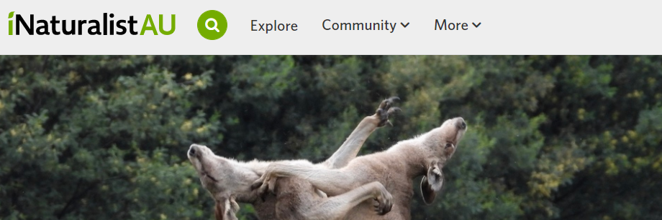
Citizens Science projects - volunteer on the south coast
Birdlife Australia Swift Parrot Search Program The first targeted survey period for 2021 commences tomorrow Saturday 24th April and continues through to Sunday 6th June. This is a six week period roughly centred around the traditional third weekend in May. The second 2021 survey period is from Saturday 17th July to Sunday 29th August – also a six week period, and centred around the traditional first weekend in August.(https://birdlife.org.au/swift-parrot).
iNaturalist State Forest online project help establish citizens science project in state forests - first of its kind in Australia for iNaturalist wth moderators
iNaturalist State Forest Project (between Moruya and Ulladulla)
and Swift Parrot Search Program 24 April to 26 June birdwatchers visiting permanent sites for regular bird surveys, tree flowering and water availability.
Helping build the online project in consultation with iNaturalist moderators, zoom meetings

Slide 12
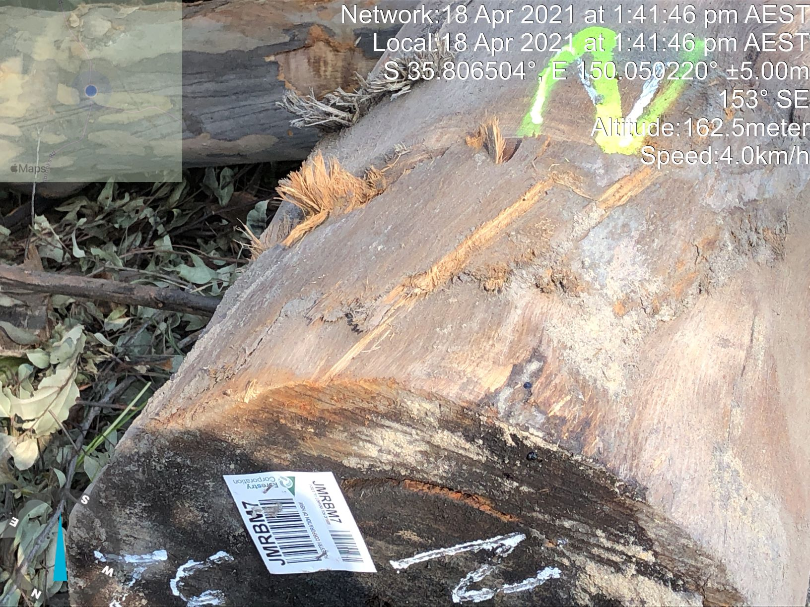
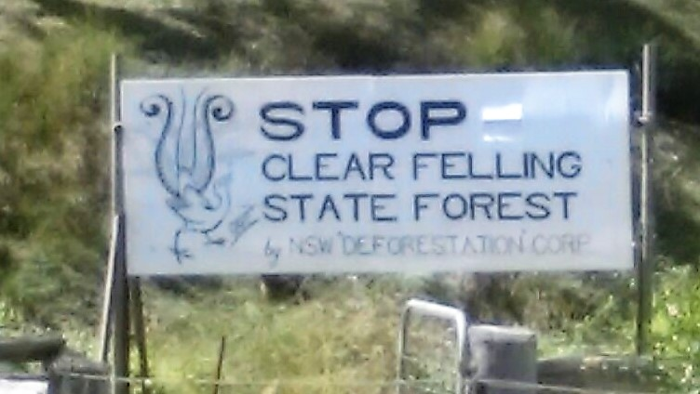
Post Logging surveying of logging practices
Swift Parrot nectar trees cut down in Mogo State Forest six weeks after FCNSW fine reported to EPA
Photo taken in on Sunday 18 April of Nectar tree cut down and barcoded in a logging pile at Mogo State forest. This and others reported to the EPA the next day.
Private contractors ignoring FCNSW marking of trees Forestry not monitoring the contractors for compliance
Logging industry unable to meet environmental logging rules Enough wood in plantation sector to meet Domestic Supply
If have botanic/bird/ mammal expertise and want to survey at the coast contact x.
Canberra Forest Alliance forestnwk@gmail.com find them on Facebook

Slide 13
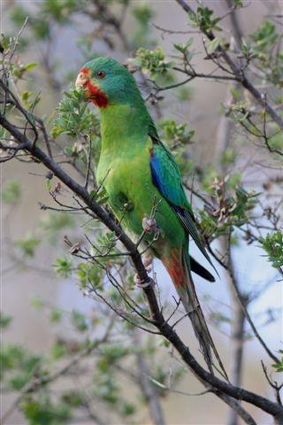
Citizens Science: Pre Logging Surveys Forestry Corporation fined $33K for failing to keep records, endangering parrots 1 March 2021
The EPA became aware that records of the critically endangered Swift Parrot were not included by FCNSW in planning NSW south forestry operations in Boyne, Bodalla and Mogo State forests.
EPA Executive Director of Regional Operations Carmen Dwyer said the failure to consider all available records during the planning phases of forestry harvesting operations could result in environmental harm and potential impacts on threatened species.
“The harvest and haul plans for the three operations confirm the Swift Parrot records were not considered and therefore the marking and retention of eucalypt feed trees did not occur either.
A local bird expert knew there were swift parrot records on the BioAtlas along Buckenbowra Road next to the compartment being logged and that there were no trees marked out with an N for Nectar (5 trees per ha extra to be protected)
Photo: Swift Parrot Birdlife Australia

Slide 14
Why Survey - Case study: Wild Cattle Creek
In July 2020 at Wild Cattle Creek State Forest two Giant Trees were cut down leading to a EPA imposed Stop Work Order (EPA have 16 matters for prosecution in the pipeline)
WHY SURVEY?

Slide 15
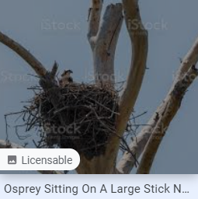
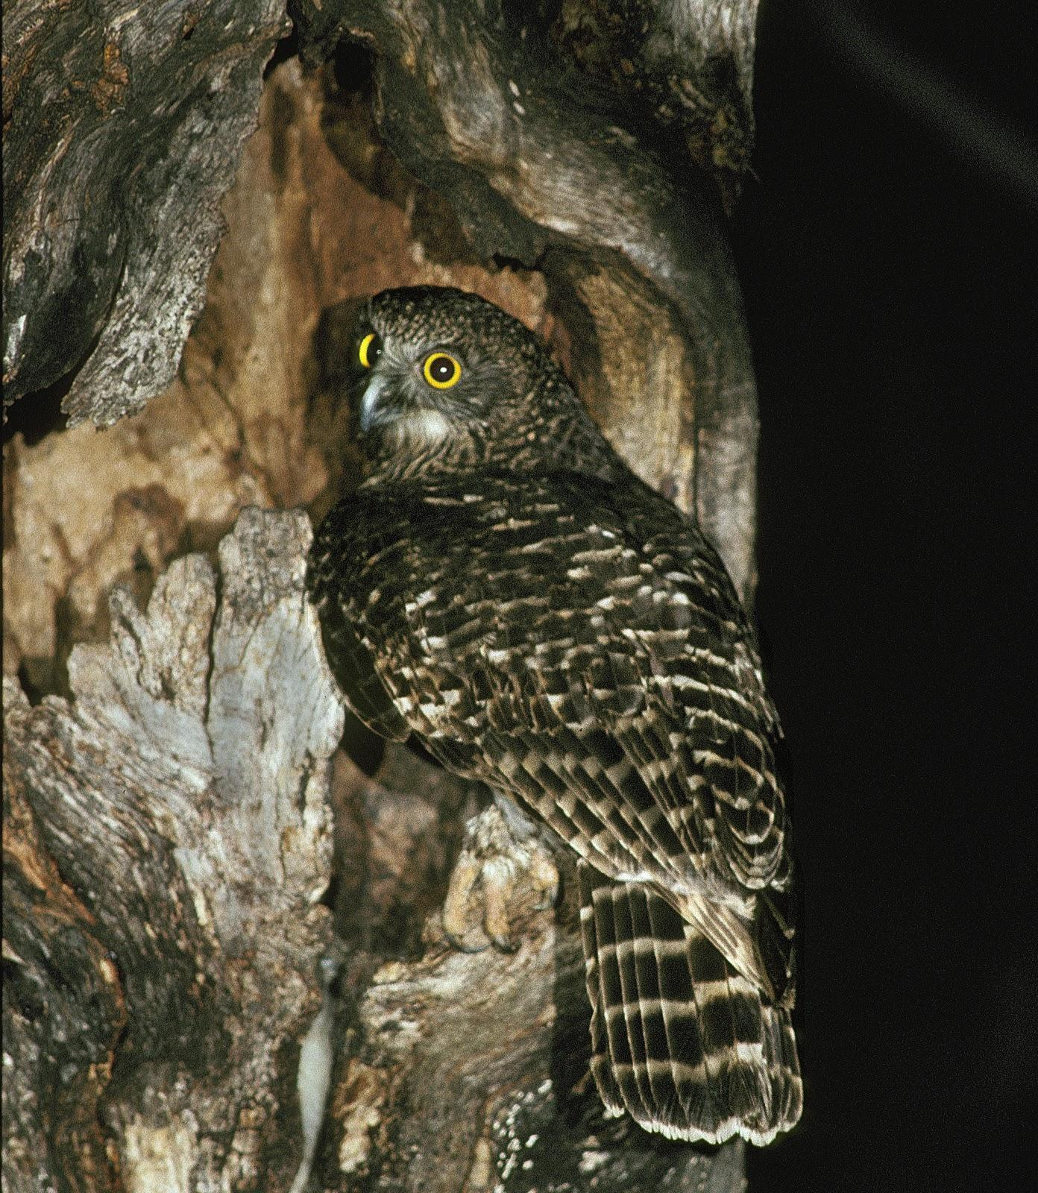
Survey for Bird roosts and nests to trigger protection in state forest to be logged
Large Stick Nest (over 50cm) 50 m radius exclusion zone around tree (while nest active)
Large forest owls - barking owl, sooty owl, masked owl, powerful owl (pic) Roost 25m EZ, Nest 50m EZ
Bush Stone Curlew Nest 100m EZ . At Corunna 300m EZ around active white bellied sea eagles nest (not in CIFOA?)
Glossy Black Cockatoo, Flame Robin , Scarlet Robin, Hooded Robin, Dusky Woodswallow, emu (nest 50m EZ)
Swift Parrot (roost 25 EZ and extra five nectar feed trees per ha) Turquoise Parrot, Gang-gang Cockatoo, Little Lorikeet, Little Lorikeet, Diamond firetail, Speckled warbler, varied sitella (nest 25 m EZ)
Grey-crowned babbler, Brown Treecreeper, Regent Honeyeater, Black-chinned Honeyeater (eastern subspecies) (nest 25m EZ)

Slide 16
Come to the NCC Nature Conservation Council regional conference Sat May 22 Batemans Bay The Fires Changed Everything
Panel - Virginia Young (Griffith Uni) - logging increasing firerisk, Graham Moore (LLS) cultural burning, Kelwyn White (Rural Fire Service) asset protection.
Workshops and networking
State of Play of logging on the South Coast, citizens science to achieve conservation outcomes in state forest including Birdlife Australia swift parrot surveys.
Manyana Matters, Nature Coast Marine Group on Marine Parks and Electric Vehicles and Microgrids.

Slide 17
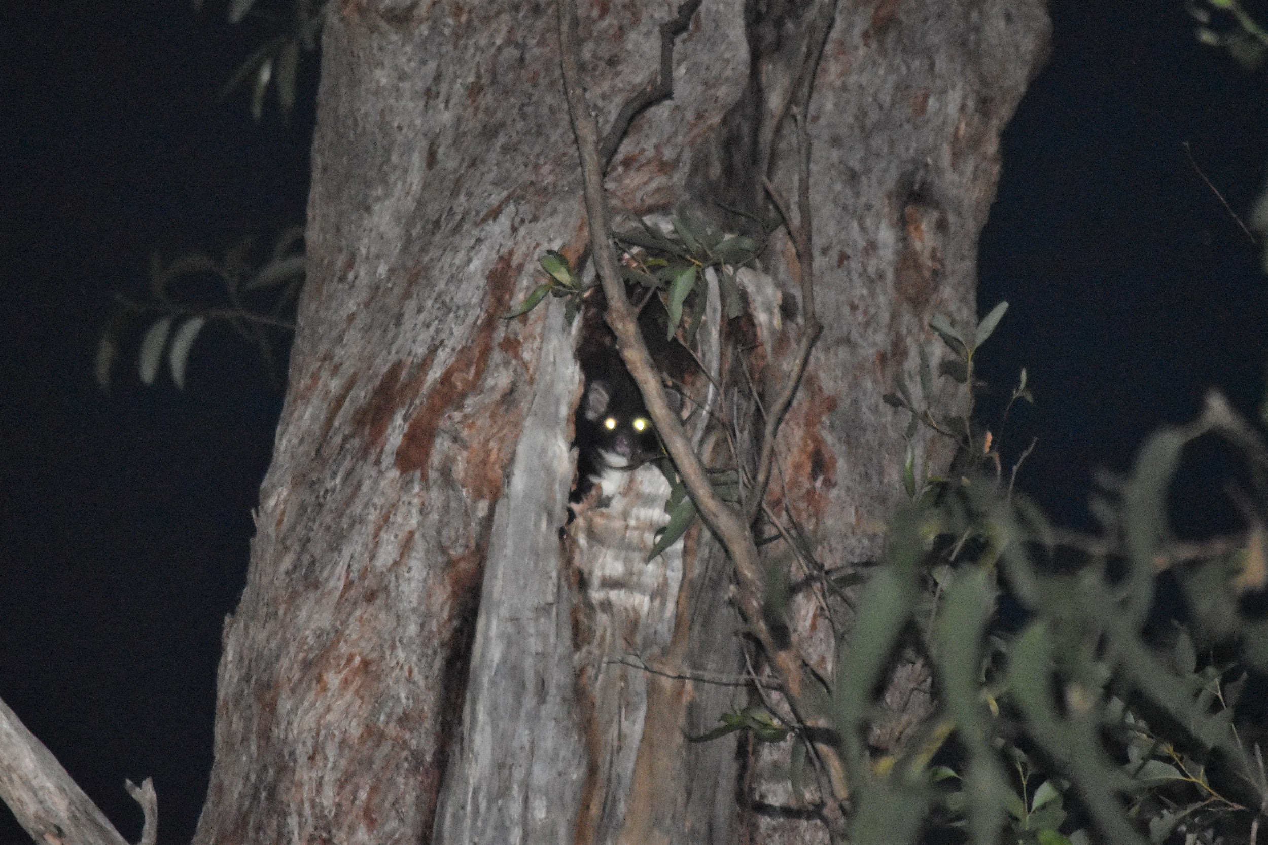
LOBBYING
I
PETITIONS
World Wildlife Fund WWF Petition in partnership with NSW Environmental Defenders Office defending the Unburnt Six including the South Coast Forest
NSW Electorates
Justin Field Fire Moratorium Logging Now Petition
David Shoebridge Hardcopy:End Native Forest Logging - Protect forests for the future
Birdlife Australia Protect Swift Parrots Forever to auto email your local pollie
Stop logging the fire ravaged South Coast Nature Conservation Council Write to your MP and tell them how vital it is we protect our fire ravaged native forests from logging.
50 years of woodchipping: It’s Time for a Change Petition On 28 Nov 2019 the woodchip mill has been going for 50 years. Check out SERCA’s scorecard. The reality for wildlife, forests, soils, water and carbon storage is grim.

Slide 18
Check websites, get on email lists & facebook pages
Nature Conservation Council
South East Region Conservation Alliance
North East Forest Alliance – look at their citizen science reports on Forestry
Coastwatchers and many small community campaigns that spring up when they subject to logging such as Brooman State Forest Conservation Group (fb page)
NSW Forest Defence (fb page)
Bushfire facts - https://www.bushfirefacts.org/
15 April 2021 WWF Australia creates legal fund to fight projects threatening forests after black summer bushfires The Guardian (the unburnt six including the south coast forest)
POSTSCRIPT: SAVING FORESTS IS CLIMATE ACTION
The bushfires are pushing more than 49 animal species towards extinction. Continuing to log native forest after the fires will be last of a thousand cuts. Let’s use Citizens Science to protect the big old trees while we push for 100% plantations. Proforestation (retaining our big trees) will reverse global warming and sustain fauna. One great example is Tasmania’s emissions fell to below net zero in a 2018 report due to the Gunns Ltd’s pulp mill not being built and reduction in logging areas.

Slide 19
More links from SERCA
Community attitudes to native forest logging
https://npansw.org.au/wp-content/uploads/2019/02/Social-License-Report.pdf
http://woodchippingsux.net/FWPA%20download.htm
http://www.chipstop.savetheforests.org.au/poll%20flyer%20A5-3polls.pdf
Subsidies to the logging industry
http://www.chipstop.savetheforests.org.au/subsidies.htm

Slide 20
Some useful references
The EPA has commissioned a 17 Sep 2020 report by independent ecologist Dr Andrew Smith (PDF 2.4MB) who considered the Coastal IFOA and site specific operating conditions in the context of the environmental risks of harvesting timber in burnt landscapes.
Two page Executive Summary with 15 dot points recommends at least 12 months of non-logging post fires. David Lindenmayer recommends 40 to 100 years. Citizens science surveys Compartment Scale Components in Table 1 (page10).
EPA Stop Work Order Fact Sheet Wild Cattle Creek Stop Work Order South Brooman State Forest Stop Work Order
NEFA audits
Enviro Justice – current Victorian Court Cases - succinct.
The Great Forest Case – Bob Brown Foundation.
Friends of Leadbeater’s Possum v VicForests Case Judgement 21 August 2020 (VicForests has appealed). Starts off with each compartment and breach that nullifies exemption from EPBC Act.
Money Doesn’t Grow On Trees - The Australia Institute - short overview
The Aim of Education is not Knowledge but Action Herbert Spencer 1820 - 1903

